Slide 1
ISD DEVELOPMENT 1ST HALF FY2022

Slide 2
FY2022 PROJECTS SUMMARY
1/5
Update 3.Oct 22

Slide 3
FY2022 PROJECTS PROGRESS
2/5
Plan
Actual
Go-live
No | Items | Dept | Apr | May | Jun | Jul | Aug | Sep | Oct | Nov | Dec | Jan | Feb | Mar
1 | Tooling Control Sheet | COS/LOG
2 | FOSS- Print partcard changing | MCS
3 | DP Prevent Double ID, MAC ID | DP
4 | Debit Note, Creditnote system upgrade | All Depts
5 | Weight Check Projector for India | PJ-FA
6 | Elearning System V2 Expand | HRS
7 | Microwave OCS upgrade PLC to PC | MW-FA
8 | Projector Traceability Optical Unit | PJ-FA
9 | Total Visualize System | All Depts
10 | Worker Management System Module: Manpower, Quality, Production (MEBD) | FA/QC
11 | Auto transfer to SAP for outside plan | MCS
12 | PMD Warehouse management Upgrade | PMD
13 | Printing area FTP configuration | PMD
14 | Auto Print Partcard preparation area | FA
15 | Auto Verify customs declaration data | SCM
16 | Auto Input tracking number to SAP | MCS

Slide 4
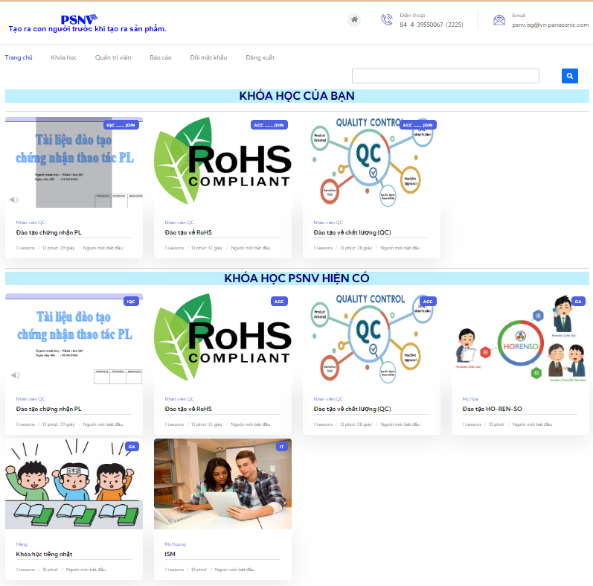







FY2022 E-LEARNING PROJECT
3/5
Reduce 60% time for making video
Reduce 50% trainer time
Online Training
Video making
Online Testing
Report
Auto Evaluation
Speech data
Merge
PPT+ Speech

Slide 5

FY2022 VISUALIZATION PROJECT
4/5
Target & Benefit:
For management:
Reduce collecting and processing PSI data
Automatize reports (Analyze with Graph/Simulation/Detect Abnormal/Reporting)
Support to make management decision quickly with high accuracy and arrange man-power to produce product swiftly and properly
For department:
Standardize master data for all category
Automatic generate and update on the fixed report
Able to create and customize report

Slide 6
FY2022 REQUEST TO DEPARTMENT
5/5
E-LEARNING SYSTEM
No | Task | Dept | Deadline
1 | Introduction and sharing to others dept | Related Dept | 14 Oct, 22
2 | HR expand to another training courses | Related Dept | Q3, 22
3 | Other depts review and register courses | Related Dept | 28 Oct, 22
VISUALIZATION SYSTEM
No | Task | Dept | Deadline
1 | PSI User list to access File server | PUR/PSCD | 14 Oct, 22
2 | Preparing data following system format | PUR/PSCD | 17 Oct, 22
3 | Register user list to access system | PUR/PCSD/PROD (BOM registered) | 18 Oct, 22
Please cooperate to complete task!

Slide 7
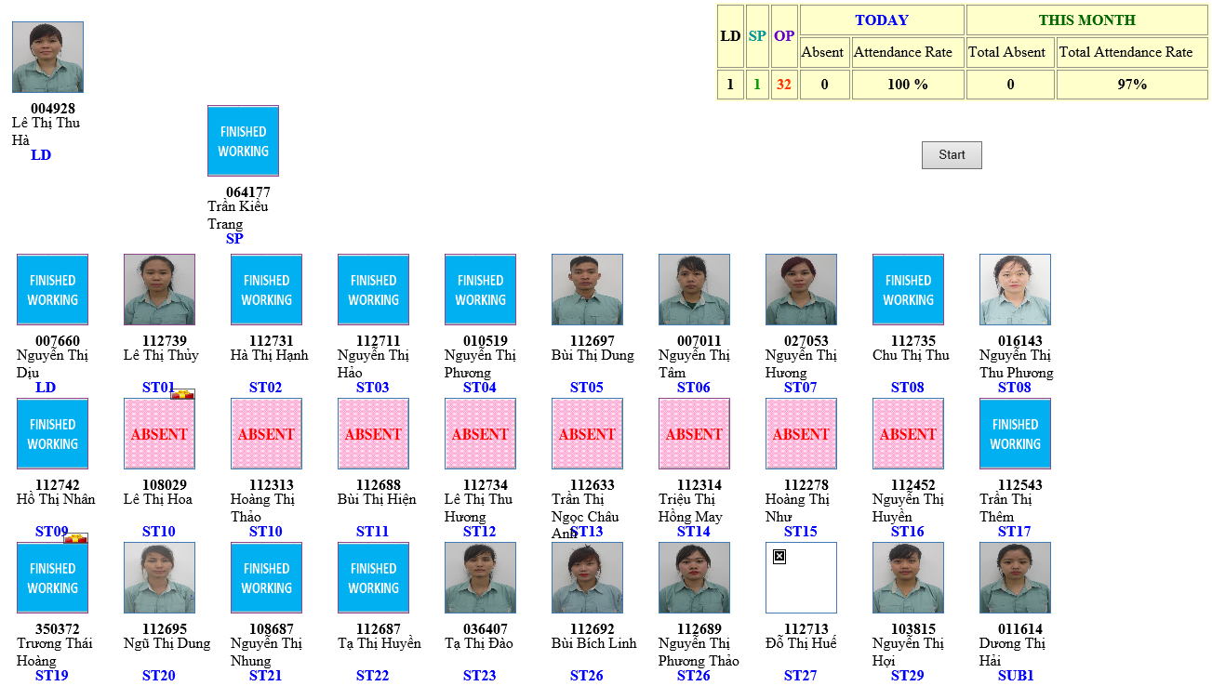
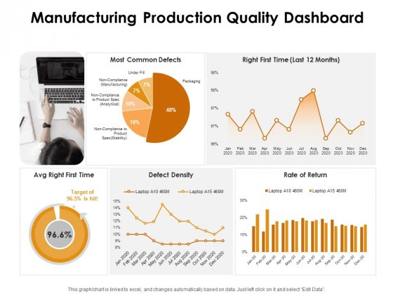
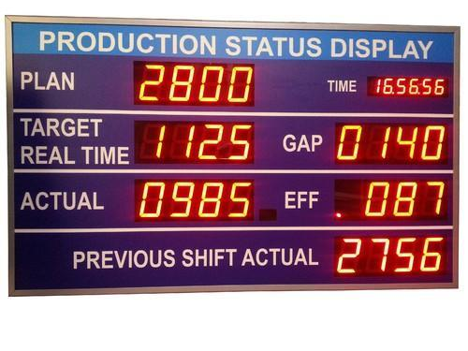
FY2022-2023 CELL MANAGEMENT PRJ
CELL MANAGEMENT
Attendance control
Multi control
Production
progress
Production
result

Slide 8




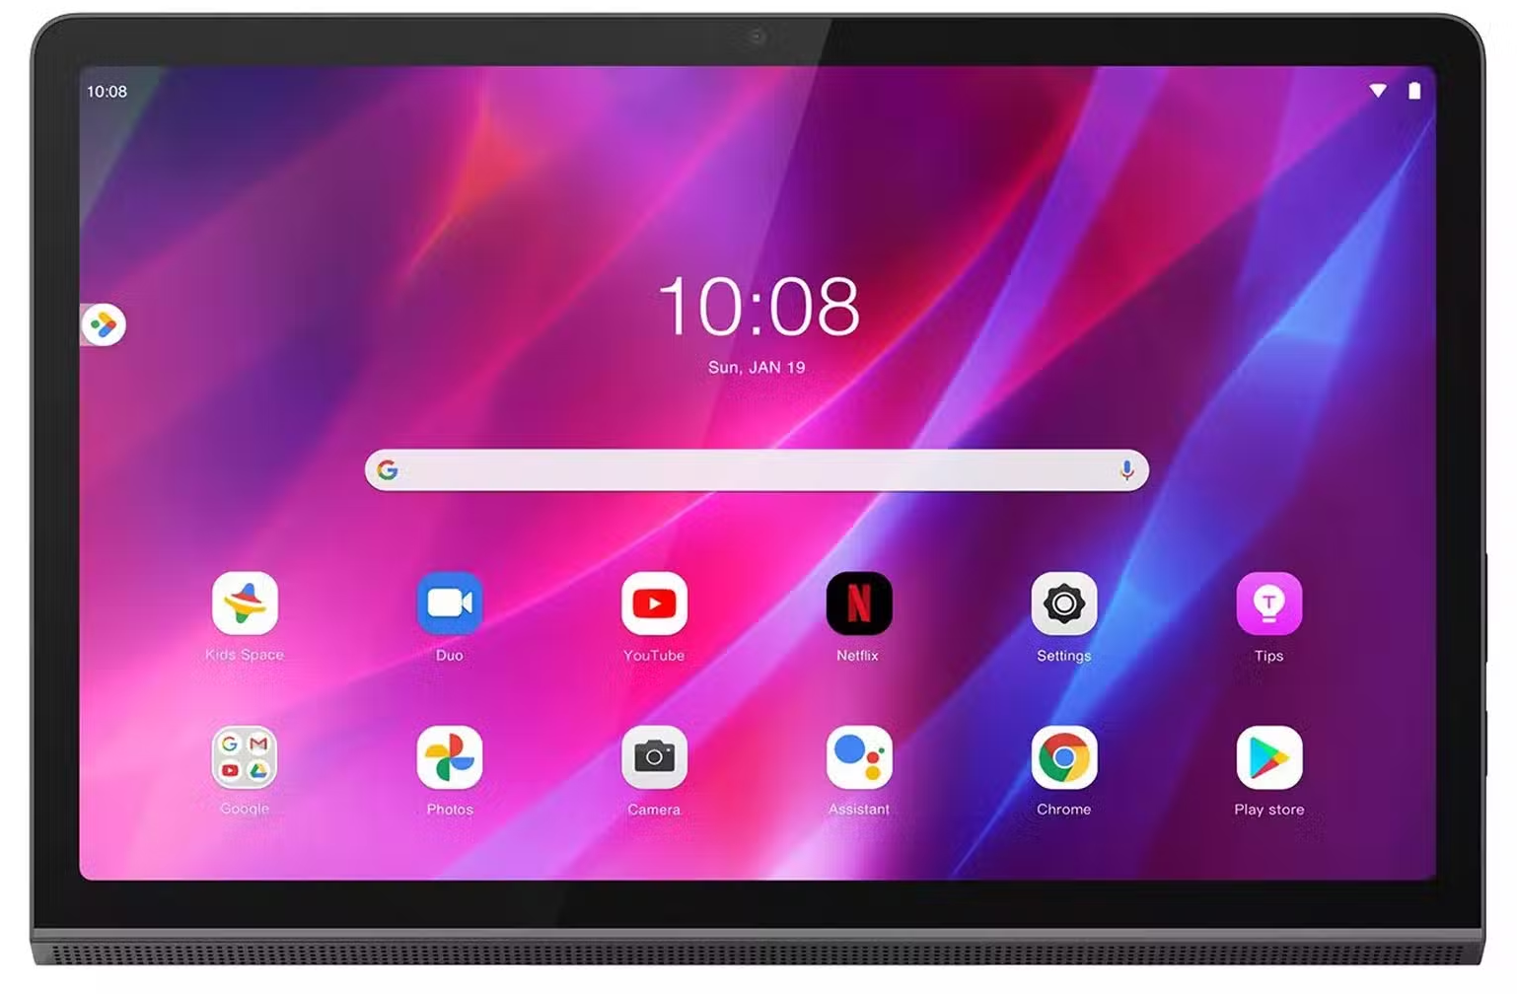
FY2023 UPGRADE FOLLOW COMPLIANCE
UPGRADE TO ANDROID DEVICE
Develop New Software
 | MCS | OTHER
Total | 140 | 6 (SCS:2, FA:2,GA:1,PE:1)
FY2023 | 20
FY2024 | 60
FY2025 | 60 | 6
Operating system:
Windows CE
Windows Embedded
Can’t upgrade android OS
END OF LIFE
2023
Compliance

Slide 9
FY2023 NEW SYSTEM SCHEDULE
x
Manpower of Project
No | Items | Dept | Q4 FY22 | Q1 FY23 | Q2 FY23 | Q3 FY23 | Q4 FY23 | FY24 | FY25
1 | Check Sheet Less (Management module) | ALL
2 | Check Sheet Less (Production module) | PROD
3 | Cell management (Quality, Production) | PROD
4 | Free location & E-map (Kitting, Supply, Inventory) | MCS
5 | FOSS system upgrade (Compliance) | MCS
6 | IoT Project (DIP,FCT,FA) | PROD
7 | PSNV Portal mobile | ALL
8 | SCM Shipment link | SCM
E-leave, in-out, Bus, OT
2
Quality, Prod result, Inspection result
Others
3
Quality system, productivity dashboard
1
Dect Phone
3
Other Cate
Basic function
Advance & expand
3
SMT -> DIP -> FCT -> FA
SCM
4
2
2

